Slide 1
Stratification, Community capitals, community organizing
Meredith Redlin, PhD
South Dakota State University

Slide 2
Diversity and stratification
Heterogeneity of population; Layers of society
Changes life outcomes for individuals and groups through differing access to resources and power
Culturally-based and temporal understandings which privilege some groups and dis-empower others
Often larger than a community, but at the community level is where change and challenge can most effectively occur

Slide 3
Built Capital
Financial Capital
Natural Capital
Political Capital
Healthy Ecosystem
Vital Economy
Social Well-Being
Cultural Capital
Social Capital
Human Capital
Notes:
Communities are systems that have assets in the various capitals that need to be used wisely.

Slide 4
Spiraling up
Capital assets as they exist (stock)
Capital assets as they are invested (flow)
Theory of cumulative causation:
Loss brings loss of multiple capitals
Success brings success and investment in many capitals
Often results in severe inequalities across places
Benefit of CCF: Systemic evaluation of a project’s impacts beyond the direct achievement of objectives and goals.
Captures increase in multiple areas of cumulative causation

Slide 5
Environmental Group Implementation | Community Organizing Implementation
Research and policy development, which results in potential cacophony of “experts” Lobbying and advocacy, which focuses on persuading elites and incremental “wins” Community education, which doesn’t necessarily prove that general knowledge leads to change in policy or behavior Media and social media promulgation, which often results in mixed messages, and serves to “dis-engage” Fundraising and recruitment, which may also simply reflect passive support. | A new theory of change, which can challenge existing power relations and set standards for appropriate and meaningful “wins” (re)Learning the craft of facilitating people’s interaction in place, building collective action, investment and follow-through Organizational change such that all staff are knowledgeable and skilled in outreach Humility and openness in the work, so that the process remains one of learning, inclusion and active engagement

Slide 6
CBNRM
Community-based and focused
Complex view of natural resource issues
Socially and culturally embedded
Action-based outcomes
Inclusion and full engagement
Sustainability as universal goal

Slide 7
Conducting a study of climate change in place
Identifying place
People and life ways
Historical , social and cultural context
Issue
WHO is having the problem? WHO isn’t?
WHY is it occurring?
WHAT can be done?
HOW can it be resolved?

Slide 8
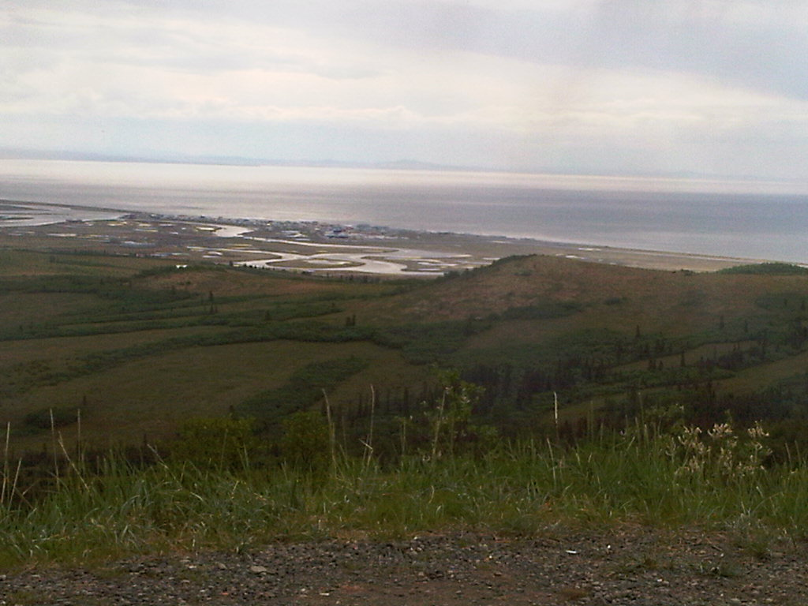
Unalakleet, Alaska

Slide 9
Population: 700, Inupiaq
Migratory stop for 15,000 years, permanent settlement for 200 years
Unemployment listed as 14.5%, but skewed as 48.6% not counted
Subsistence activities (fishing, netting, hunting, trapping, berry picking, whaling) encompass most of summer months combined with part-time winter employment

Slide 10
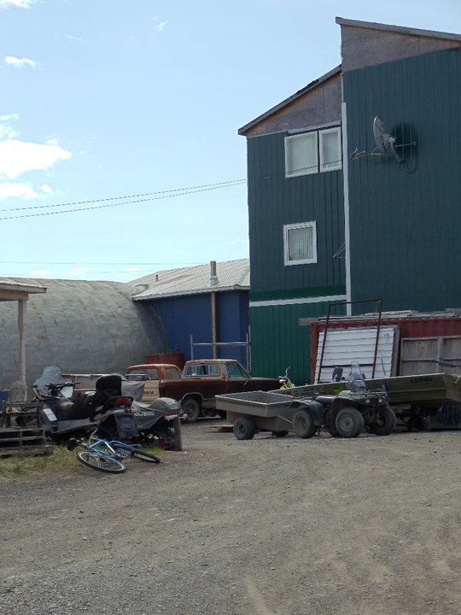

Slide 11
Key resources: moose and salmon
Moose most important for hunting in last 20 years, as caribou migration route has moved north over 100 miles in that time. By 2004, great impact on moose population
State governance and oversight through Fish and Game Department; Local governance through traditional leadership and collective decision-making

Slide 13
Event: Caribou habitat moves north
Hunters turn to moose for subsistence
Large carnivores also turn to moose
Moose population collapses
Traditional practices are impacted, limiting social and cultural capital
Village well being is impacted
Outfitting and other moose-related markets are negatively impacted

Slide 14
Traditions and sovereignty are stronger; economy improves
Subsistence and other moose-related activities are revived
Political capital and values related to sovereignty lead to policy development; Political capital leads to state adoption
Traditional practices are implemented and TEK reinforced
Moose population comes back
Cultural capital provides the basis for advocating for change
Social capital brings people together to address the issue

Slide 15
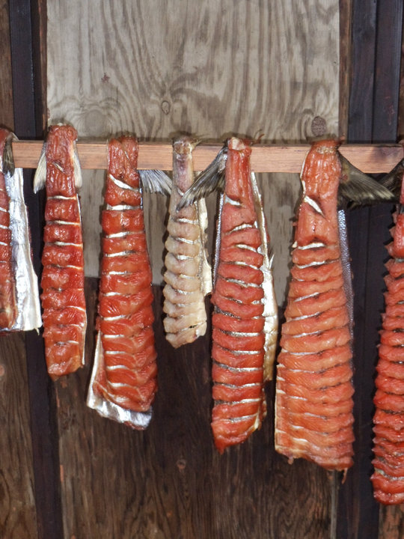

Slide 16
Salmon is primary food source; 60% of all dietary protein comes from salmon (Art Ivenoff, personal interview). Precipitous decline in salmon population in the last two decades.
State and Federal governance through Magnuson-Stevens Act of US Congress and establishment of Northern Pacific Fishery Management Council (with 8 regional subcouncils) and Alaska State Department of Commerce
60% of appointed council members have direct financial interest in fisheries they manage; 100% of NPFMC have direct financial interest

Slide 17
Season is later and less salmon come
Less opportunity to practice subsistence
Villagers must search for alternative food sources
Traditional giving to elders and those in need lessens
Breaking down of traditional values and community cohesion
Devaluing of TEK
Village, family and individual well being is impacted
Continuing decline of fisheries

Slide 18
Understanding the Difference: diversity, stratification and CBNRM
Diversity impact: Inupiaq people have the legal right as well as the institutional and financial ability to participate as equals in these decisions.
Stratification impact: However, “what is missing is frequently not the desire to act or even the resources, but the authority” (Oakerson 2008:179).
Structural levels for moose (local and state) allow for authoritative influence of indigenous knowledge and leadership and therefore, successful adaptation plan for Moose through CBNRM.
Structural levels for salmon (federal, state and commercial) precludes local or noncommercial authority, therefore limiting adaptation planning and CBNRM for salmon.

